Slide 1

Infosys Summer Of Ideas 2020
Team: FlyPhishers
Captain: Benjamin goh

Slide 2

Phishing
Phishing sites are a threat to everyone as they try to steal confidential data. Measures to help identify and avoid Phishing attacks are:
Knowledge of known phishing techniques
Random popups
Type URL of known site instead of clicking a picture of link claiming it will bring you there
Properly closing
Site security
HTTP vs. HTTPS
Avoid sharing personal information

Slide 3

Problem Proposal
Create a Chrome extension capable of:
Alerting users if they are visiting an insecure site
Identify if a website is a known phishing website
Use machine learning to identify malicious websites
Checking emails as possible phishing attempt

Slide 4

Other available extensions
There are a number of chrome extensions available for detecting phishing websites. But they generally end up checking for either HTML of page or page URLs or running ML algo on URLs.
While our extension will combine almost all known techniques to save users for Phishing websites

Slide 5
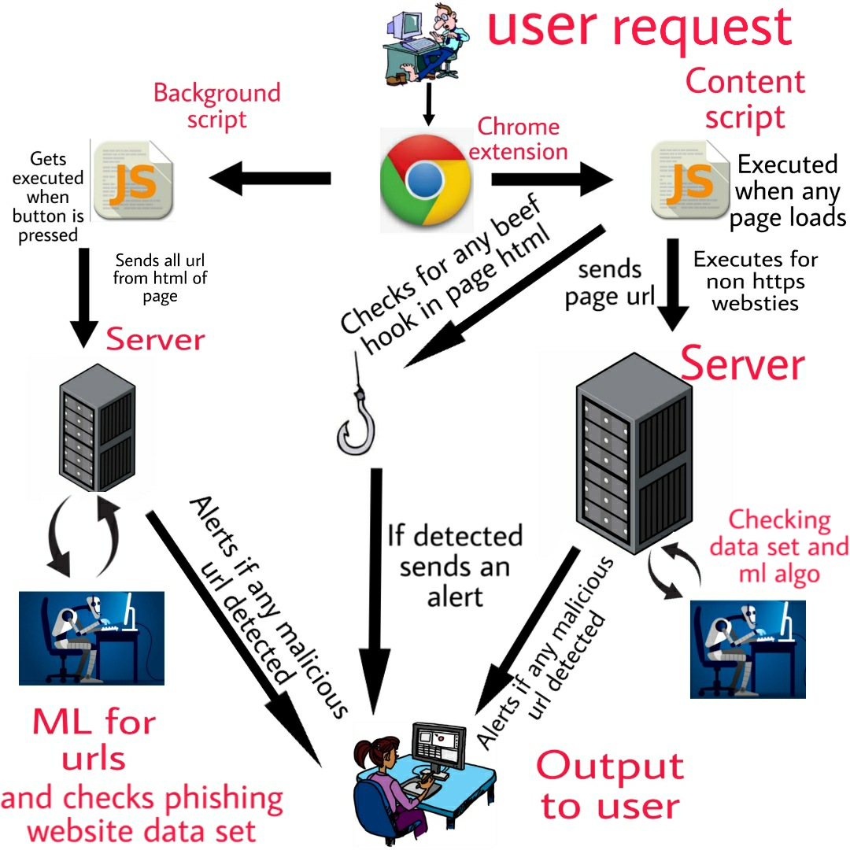
Solution: Phishing Detector
Five checks
Site URL scan
HTML page scan for BeEF hooks
Check if any URL is directing to an ip intead of domain
Checks if any site is trying to download any exe or zip files.
HTML page scan for malicious URLs
Three methods for checking
HTTPS vs. HTTP
Index database of known phishing sites
Machine learning

Slide 6
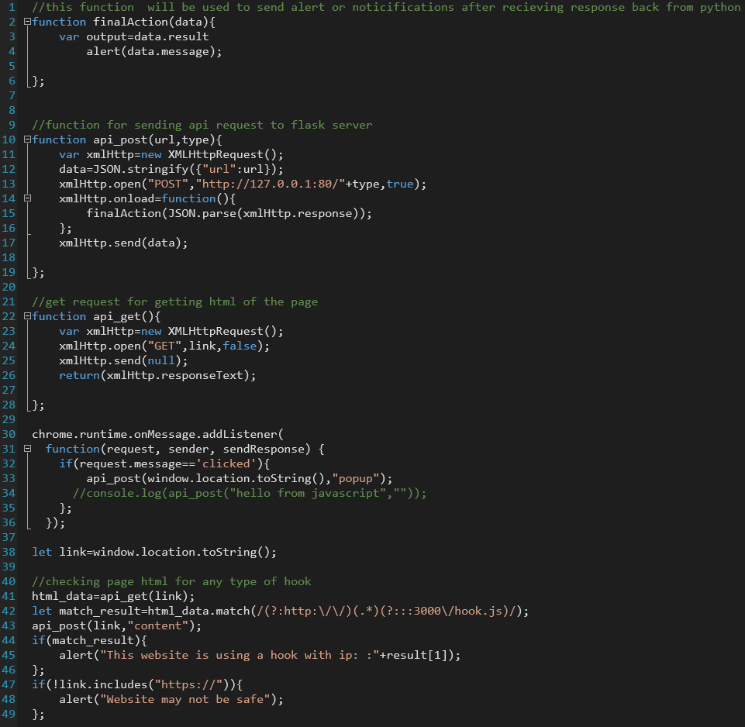
Content Script
Runs in background
Triggered when new page is loaded
Sends page URL and HTML code of page to backend server
Server checks URL
It conducts all checks on URL of the page but for checking Beef hook it scans the whole page HTML

Slide 7
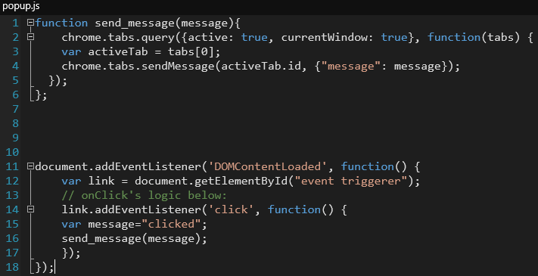
PopUP Script
Executes when user presses a button
Extracts all embedded URLs from HTML of page
Machine Learning algorithm checks URLs
URLs compared to known phishing URL database
Can detect phishing emails

Slide 8
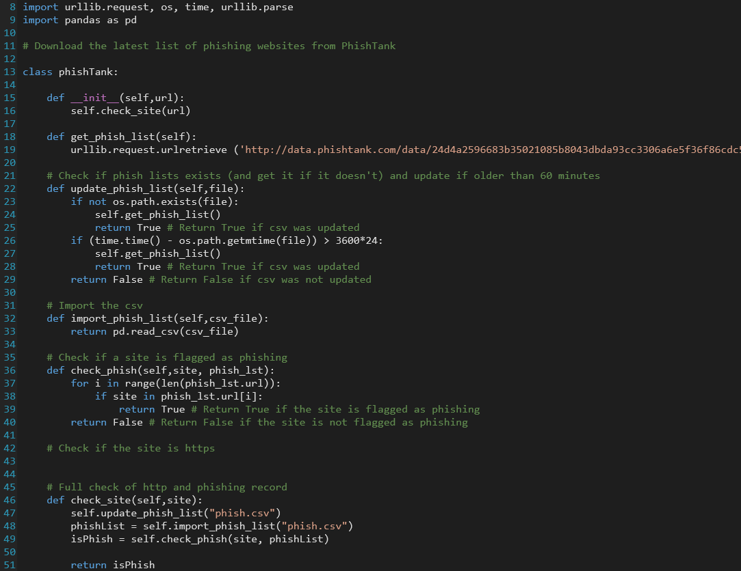
Phish Database
PhishTank is a website that receives and verifies phishing websites
Pull list from website to compare links to

Slide 9
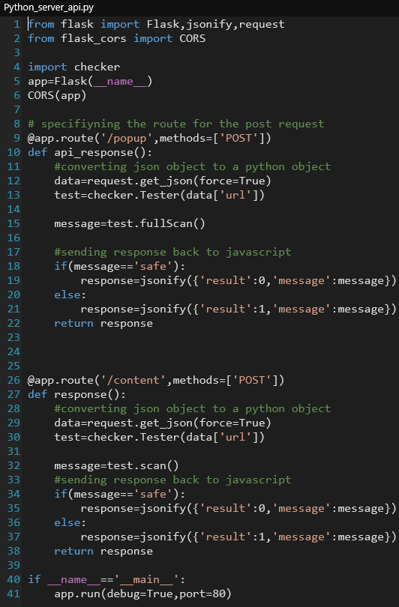
Client Server Communication
Server: Flask server
Client: chrome extension
Client sends URLs to server
Server runs checks
Server returns results to client
Client sends results to user

Slide 10

Brief overview of techniques used to detect phishing websites
HTTPS checker - It is a regular check which the current page HTML ,and continues to further checks if its HTTP website , as there its very rare to find a HTTPS website to practice PHISHING techniques.
Beef Hook - Beef is the most commonly used Web Browser Exploitation Framework . It needs certain javascript code to be used in HTML for Exploitation . Our extension will check for that code in page HTML.
Phish Tank - URL in the page or URL of the page are checked in an online dataset known as Phish Tank.
IP address - Normally URLs have domain names and don't use direct IP addresses ,while when a hacker creates a malicious URL he/she generally uses IP address in the link. Our extension will alert user if any IP address is found in any URL in page.
Exe and Zip - Phishing sites try to send Malware ,Viruses ,Trojans, Rootkit , etc in form of either exe or zip file . Extension will alert user , when user tries to download any file by checking its URL.
Machine Learning - At last we pass the URL through a machine learning algorithm which is trained on dataset of previously known Phishing Websites and checks some kind of URL writing way of URLs.

Slide 11
Thank You

